Slide 1

Cloud BU
Hackathon(01-April-2023)
Team-Warrior
Subject-Battleship Game
COMMUNICATIO INDUSTRY EXPERTS

Slide 2
Hackathon(01-April-2023)
Team-Warrior
Subject-Battleship Game

Slide 3
Introduction
Battleship game is a strategy type guessing game for two players. It is played on ruled grids on which each player’s fleet of warship are marked. Players alternate calling “shot” at the other player’s ship and the objective of the game is to destroy the opposing player’s fleet.
The game of battleship is originated from French game L’Attaque played during world war-1.

Slide 4
A map of one player’s ships and the hits against them from a game in progress. The grey boxes are the ships placed by the player, and the ross marks show the squares that their opponent has fired upon. The player would be tracking the success of their own shots in a separate grid

Slide 5
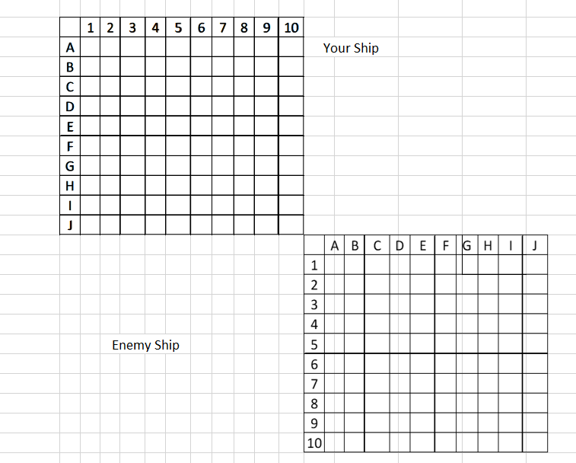

Slide 6
Flow Chat
Start
Create Four Grids
Yes
If Hit Ship
No
Ship will Sink
Allows Further
Yes
If hit
No
Ship Sinks
Allows Further

Slide 7
The Game is played on four grids, two for each player. The grids are typica square – usually 10*10 and the individual squares in the grid identified by letters or number.
On one grid the player arranges ships and records the shots by the opponent. On the other grid, the player records their own shots.
Before play begins, each player secretly arranges their ships on their primary grid. Each ship occupies several consecutive squares on the grid, arranged either horizontally or vertically.
The number of squares for each ship is determined by the type of ship. The ships cannot overlap (i.e. only one ship can occupy any given square in the grid).

Slide 8
The types and numbers of ships allowed are the same for each player. These may vary depending on the rules.
The ship should be hidden from players sight, and it’s not allowed to see each other’ pieces.
The game is a discovery game which players need to discover their opponents ship positions.

Slide 11

…Thank You…

